Slide 1

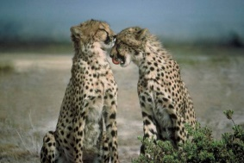

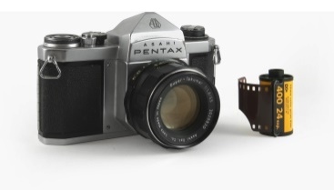
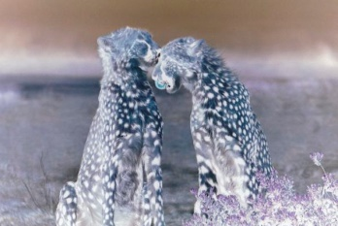
What is a Docker Image?
Analogy between the Docker Image & Camera
Docker Image
Container-1
Dockerfile
Container-2
Introduction

